Slide 1
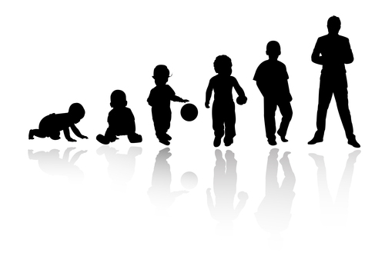
Play for Health: A Journey Through Life Julia Whitaker, Health Play Specialist

Slide 2
Or … Why a kindergarten stage is important for our children’s health
‘The desire for playful activities is universal, and in the human species it transcends age.’
(Moya 2014)

Slide 3
Deprived of play, the child is a prisoner, shut off from all that makes life real and meaningful.’ (Susan Harvey, 1972)
The seeds of play for health were sown by The Platt Report (1959) which highlighted the need for play for sick children to be organised under skilled supervision of suitably qualified professionals, in order to reduce the negative effects of separation of mother and child, disturbance of routine and lack of training for doctors and nurses regarding the emotional and mental needs of children.
The subsequent setting-up of playschemes in hospitals by the Save the Children Fund was the start of a 60 year evolution which has seen play recognised as an essential component of paediatric healthcare.
Health play specialists have moved beyond the hospital boundaries to work in schools and community settings to protect and promote children’s health and wellbeing through the medium of play.
Notes:
The seeds for play for health were sown by The Platt Report (1959) which highlighted the need for play for sick children to be organised under skilled supervision of suitably qualified professionals in order to reduce the negative effects of separation of mother and child, disturbance of routine and lack of training for doctors and nurses regarding the emotional and mental needs of children.
The subsequent setting-up of playschemes in hospitals by the Save the Children Fund was the start of a 60 year evolution which has seen
play recognised as an essential component of paediatric healthcare. Health play specialists have moved beyond the hospital boundaries to work in schools and community settings – even in one case in a prison – to protect and promote children’s health and wellbeing through the medium of play.

Slide 4
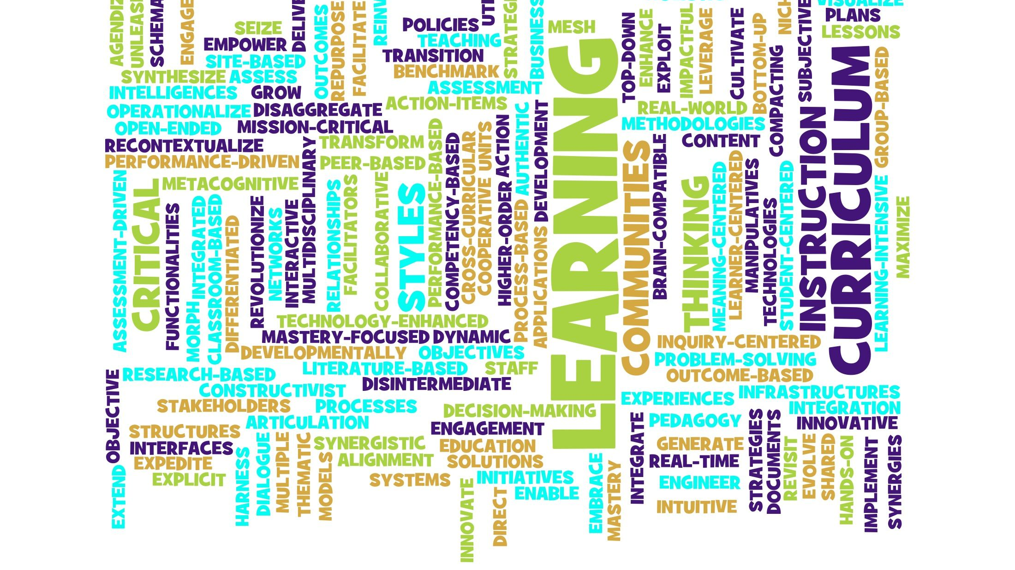
‘Education’? What’s that all about then?
‘Children (rid of us) are Biologically designed to educate themselves through play and exploration! We don’t need to educate them, we need to provide the conditions to allow them to educate themselves!’
(Peter Gray)
Notes:
Disclaimer: I am not an educationalist

Slide 5
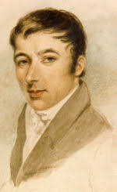
Robert Owen Kindergarten Pioneer
‘The children were not to be annoyed with books; but were to be taught the uses and nature or qualities of the common things around them, by familiar conversation when the children’s curiosity was excited so as to induce them to ask questions respecting them.’
(The Life of Robert Owen. Vol.1)
Notes:
Approximately 200 years before Peter Gray, our own home-grown advocate for play in education had the same message.

Slide 6
The Paradox of ‘Professional Play’
Perhaps play would be more respected if we called it something like “ self-motivated practice of life-skills,” but that would remove the lightheartedness from it and thereby reduce its effectiveness. So, we are stuck with the paradox. We must accept play’s triviality in order to realize its profundity.
Peter Gray, Free to Learn
Notes:
And this is where I have to part company with PG … If I am trying to ‘sell’ the idea of play to an NHS manager, an orthopaedic surgeon or a short-staffed ward sister, I don’t want to be talking ‘trivial’ and ‘lighthearted’. I need to translate ‘play’ into a language my audience understands. In healthcare, we need to talk increased efficiency, cost savings and a little bit of ‘patent experience’. It’s a compromise but trivial just doesn’t cut it in austere times.

Slide 7
WHY PLAY … ?
A child’s personal play history is one of the best indicators of their lifelong health and wellbeing.
Like sleep and nutrition, play is a fundamental factor in keeping us fit and well
Notes:
When Health Play Specialists work with a child or family, we are not just trying to help that child or family get through what is potentially one of the most traumatic experiences of their short lives or to provide a quality healthcare experience … although that maybe the momentary goal … but what we are doing is giving that child and family the opportunity to LEARN about themselves and each other and the world in which they live, in a deep and meaningful way
For it is in this way they acquire a repertoire of skills and behaviours which will make a real difference to how they go forward in life. Their perceptions of themselves and of life itself are fashioned by what they discover during that play interlude.
We can intervene at a very mechanistic level, get the child through whatever they need to get through (whether that be major heart surgery or, in your case, their primary education) but if we do that, we become just another cog in the wheel of an outcome-driven system. Whereas we have the opportunity - and the privilege – of creating real and last change, not just in the lives of individuals but in the contribution we make to cultural change.

Slide 8
What is this thing called PLAY … ?
Play is PHYSICALLY ACTIVE
Play is MENTAL CAPITAL
Play is SELF-EXPRESSION
Play is EMPATHY
Play is ADAPTIVE RESILIENCE
Play is a UNIVERSAL RIGHT
Notes:
So, we cande-construct the concept of play in order to re-package (or re-construct) it for our intended audience, emphasising that play is not a ‘trivial’ matter, not just about making childhood – or that thing called ‘education’ – more engaging, happier, more successful, but that play is essential to public health and to creating a ‘culture of health’ with profound consequences for the nature of society.

Slide 9
PLAY is ….. PHYSICAL ACTIVITY
WHO recognises the need to promote physical activity across the age range to improve rates of so-called ‘modern mortality’ conditions: coronary heart disease, high blood pressure, stroke, type 2 diabetes, metabolic syndrome, colon and breast cancer and depression.
PLAY is specifically mentioned as one of the ways in which adults can be more physically active.
Notes:
The first thing a Play Specialist will think about when they meet a child is how to engage them in active, physical play.
Young humans are biologically designed to move … We celebrate and encourage this for the first 3 or 4 years – and then tell them to ‘sit still’, ‘don’t fidget’ and reward passivity. We are all too familiar with the so-called ‘obesity crisis’ – a term that seems to have lost any useful meaning. What we have is an ‘inactivity crisis’ – essentially we spend too much time sitting-down and then we reach a certain age and feel the consequences of our inactivity.
In old age, there are particular benefits to physical play in terms of ‘cardiorespiratory and muscular fitness, bone and functional health… [and a reduction] in the risk of non-communicable diseases, depression and cognitive decline’.
Recent research into the so-called ‘super-agers’ shows that they have maintained physically active lifestyles by doing the things they enjoy.
All these benefits of a physically active lifestyle derive from the value attributed to play in childhood. When we know about the importance of keeping moving for our long-term physical health, why do we start-out trying to STOP children from doing what comes naturally … sit still, don’t fidget, legs in a basket … We need children to move, to enjoy the way their bodies feel when they move, to develop an ‘activity habit’ which will mean that they continue to enjoy being physical as they move into adulthood.

Slide 10
PLAY is … MENTAL CAPITAL
‘Play which taps into our ability to experience curiosity, competence and reciprocity and makes it possible for us to exercise autonomy, mastery and a sense of purpose offers some of the most engaging play of all.’ (Gauntlett et al 2010)
Notes:
We’re back to Peter Gray again. Young children don’t need formal schooling …
Evidence suggests that our engagement with learning is initially driven by situations and contexts, and through positive feedback and experiences we become more self-directed in pursuing the subject of our interest.’
Why is it important to our health to be curious and creative …

Slide 11
The repetitive, consistent, predictable elements of play help to organise and promote the neural systems which are responsible for complex cognitive (as well as social, emotional and motor) function.
Play is self-reinforcing because it feels good. Pleasurable experiences activate the brain reward pathways, motivating the individual to repeat the rewarding behaviour and thus establish a circular process memory of ‘curiosity, pleasure and play’ (Perry et al 2000).
Notes:
Mental capital means the degree of mastery of life skills at the time an individual faces the choices of life. The UK Government’s Foresight project looking at how to improve mental capital and mental wellbeing through life and recognises the unique contribution made by play – what I have referred to as an individual’s ‘play history’.

Slide 12
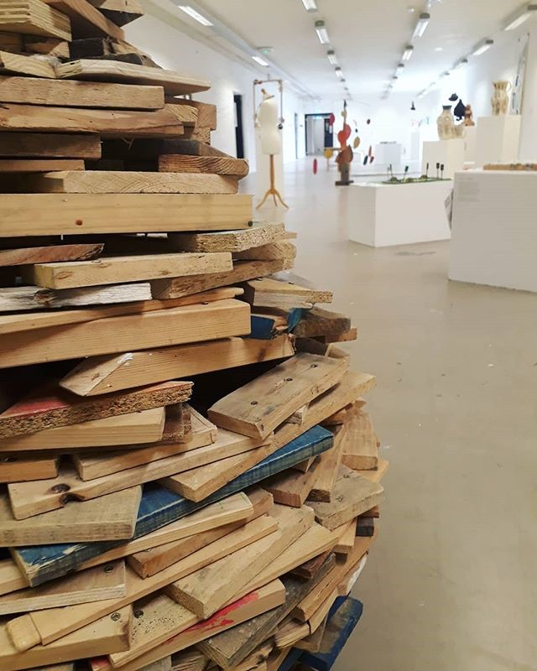
PLAY is …… WELLBEING
‘When it comes to beefing up your happiness, it’s hard to do better than engaged play. Not only does it align you with your deepest needs and deliver fun in the moment, but the social component of play is a huge predictor of increased daily well-being.’ (Robinson 2017)
Image courtesy of:
https://www.instagram.com/p/Bj2zj7HjdsS/?hl=en&taken-by=garvaldartists
Notes:
Play is the closest reflection of the ‘true self’ (Waterman, 2015). Activities which are self-chosen and intrinsically-motivated, and which include elements of ‘personal expressiveness’ satisfy core self-determination needs such as autonomy and competence and contribute to the integration of the different parts of the self and thus to optimal psychological functioning.
Play: Create: Relate.
The recent art show by Garvald Edinburgh included this ‘flower’ by Stuart Anderson, an artist with additional support needs. Stuart spent 3 years creating this piece from offcuts of wood from the carpentry workshop where he works, resulting in a sculpture of great beauty which conveys communicates a beautiful message about how the parts of ourselves – or of our society – which we discard or dismiss – each have their own unique place in creation.
For decades, there has been an accepted understanding that the best way to address psychological stress or distress (what we call mental health) is to talk about it. Now, I’m all for talking but the research now shows that active ‘doing’ of something pleasurable which is self-chosen and open-ended (play!) can reduce symptoms of anxiety, depression and despair. In 2017, the All Party Parliamentary Group (APPG) on Arts , Health and Wellbeing produced a report advocating the creative arts as a first line prevention and treatment alternative for a whole range of mental health issues throughout the lifespan.
So it follows that, just as we need to encourage children’s natural inclination for physical play, so we must allow and encourage and facilitate their creative expression, not just because it’s a nice thing to do … but because discovering the self-soothing that can be derived from painting a picture, or throwing a pot or the repetitive act of knotting or crochet might just save their sanity – even their lives – when they face exam pressures or split from their first romantic partner or miss-out on a job offer or any of life’s many developmental stages.

Slide 13
PLAY creates … EMPATHY
‘The quality of social relationships is directly linked to mortality in a manner ‘comparable with well-established risk factors for mortality such as smoking and alcohol consumption and [exceeding] the influence of other risk factors such as physical inactivity and obesity’
(Meier 2013: 2).
Notes:
As the 21st Century unfolds, there is a new killer on the block ….
Loneliness
Relationship quality is specifically linked to the main areas of public health concern: child poverty, infant attachment, mental health, obesity, alcohol/substance misuse, cardiovascular disease and dementia.
How do we learn to be with other people … through play! First in that attachment relationship to the parent … children whose parents play with them during the first year of life, demonstrate greater empathy in later childhood. In young adulthood, our romantic relationships are nothing if not playful. Social engagement in the workplace and wider community revolves around the capacity to engage socially – and with empathy – with those around us.
It has been said that we are living in a society in which there is an ‘empathy deficit …

Slide 14
PLAY builds ADAPTIVE RESILIENCE
‘Play is a protective shield against the potentially damaging effects of early social and emotional disadvantage.’
(Ginsberg and Jablow, 2014)
Notes:
Many of us have spent the past couple of years analyzing, sharing, and acting on the ACEs research. We know that a robust play history can make the difference between whether we sink or swim in the tide of adversity. When children immerse themselves in the pleasure of play, they learn that there is ‘good’ in the world and that the ‘good’ is within their reach and that they can be instrumental in modifying their experience of life’s ups and downs.

Slide 15
PLAY is …… A UNIVERSAL RIGHT
UNCRC Article 24
‘ … the right of the child to the enjoyment of the highest attainable standard of health …’
UNCRC Article 31
‘… the right to rest and leisure, to engage in play and recreational activities appropriate to the age of the child …’
Notes:
Every child has the right to play – in hospital, in school, in their streets and communities. When all else fails, we can fall back on this fact.
Health equity is a fundamental public health concern, not only because it is essential to an individual’s wellbeing and to their ability to be fully engaged in society, but because a healthy society is necessary for social, economic and political stability (Braveman et al, 2011).

Slide 16
The future foretold …?
‘ …Play will become so valued by adults who will have the leisure, health and technological resources to engage in more play themselves, that the value of play for children will be more recognised …’
However …
‘Play will be taken over by adults [who] will require children to earn the right to play, after they have mastered some authoritatively determined body of knowledge.’
(Bergen and Pronin Fromberg 2006: 418)
Notes:
NO! A right does not need to be earned … in the classroom or anywhere else.

Slide 17
The Play Journey … from cradle to grave: The difference between life - and a life worth living.
Play is a matter of survival.
It is fundamental to our health and development, to our relationships and to our capacity for learning and adaptation to change.
‘ …But in the end the most significant aspect of play is that it allows us to express our joy and connect most deeply with the best in ourselves, and in others.’
Stuart Brown, 2008
Notes:
Sorry Peter Gray but when it comes to health, our health, the health of our children, the health of society, play is not trivial, it is a matter of survival – physical, mental, social survival in an ever-changing world. And it is that play which will make our lives and the lives of our children worth living.
But it is PROFOUND in the dictionary definition of the word because it is about both KNOWLEDGE and INSIGHT and how the two intersect.

Slide 18
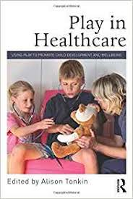
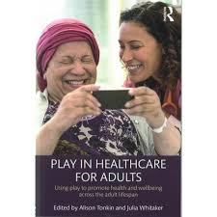
Thank-you Upstart! Julia Whitaker, Health Play Specialist: juliafreya@btinternet.com
Coming soon (2019)
Play for Public Health and Wellbeing: Edited by Julia Whitaker and Alison Tonkin.

Slide 19
References:
Braveman, P. A., Kumanyika, S., Fielding, J., LaVeist, T., Borrell, L. N., Manderscheid, R. and Troutman, A., 2011, ) Health Disparities and Health Equity: The Issue is Justice. Am J Public Health. 101(Suppl 1): 149–155.
Brown, S., 2008, Play is more than just fun. https://www.ted.com/talks/stuart_brown_says_play_is_more_than_fun_it_s_vital?language=en
Gauntlett, D., Ackermann, A., Whitebread, D., Wolbers, T. and Weckstro, C., 2010, The future of play. Defining the role and value of play in the 21st century. Billund: The Institute.
Ginsberg, K. R. and Jablow, M. M., 2014, Building Resilience in Children and Teens. Giving Kids Roots and Wings. American Academy of Pediatrics.
Gray, P., 2013, Free to Learn: Why Unleashing the Instinct to Play Will Make Our Children Happier, More Self-Reliant, and Better Students for Life. Basic Books.

Slide 20
References Cont.
Meier, R., 2013, Relationships: the missing link in public health. London: The Relationships Alliance.
Moya, M. C., 2014, Playful Thinking for Adults: Engaging the Brain Without Gadgets [Kindle version]
Owen, R., 1920, The Life of Robert Owen. Vol. 1. Knopf
Panksepp, J., 2008, Play, ADHD and the Construction of the Social Brain. American Journal of Play
Perry, B., Hogan, l. and Marlin, S. (2000) Curiosity, Pleasure and Play: A Neurodevelopmental Perspective, HAAEYE Advocate, August 2000: 9-12.
Robinson, J., 2017, The Key to Happiness: A Taboo for Adults? Available online. HTTP: <https://www.huffingtonpost.com/joe-robinson/why-is-the-key-source-of-_b_809719.html> (accessed 7 February 2018).

