Slide 2
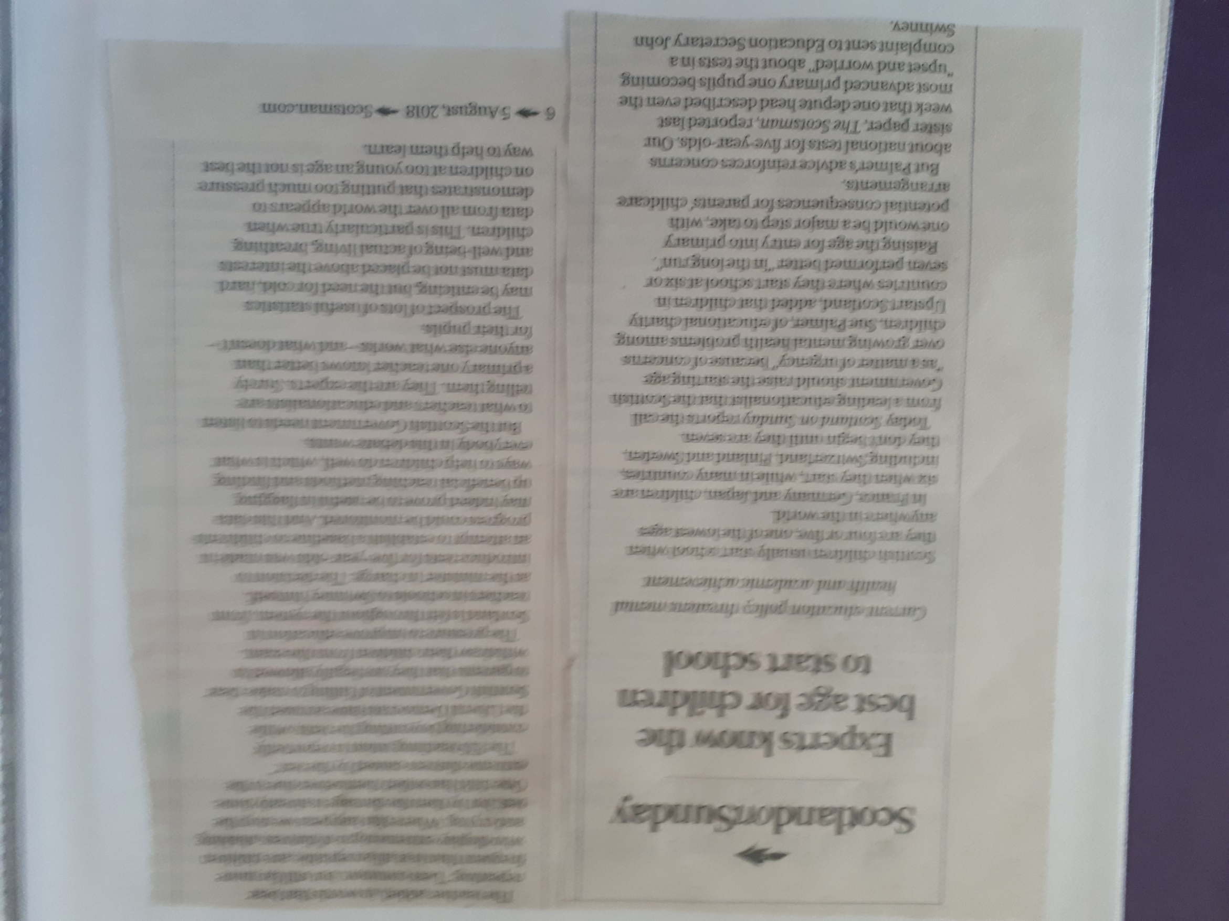

Slide 3
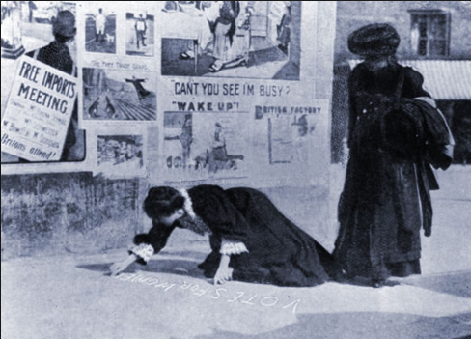
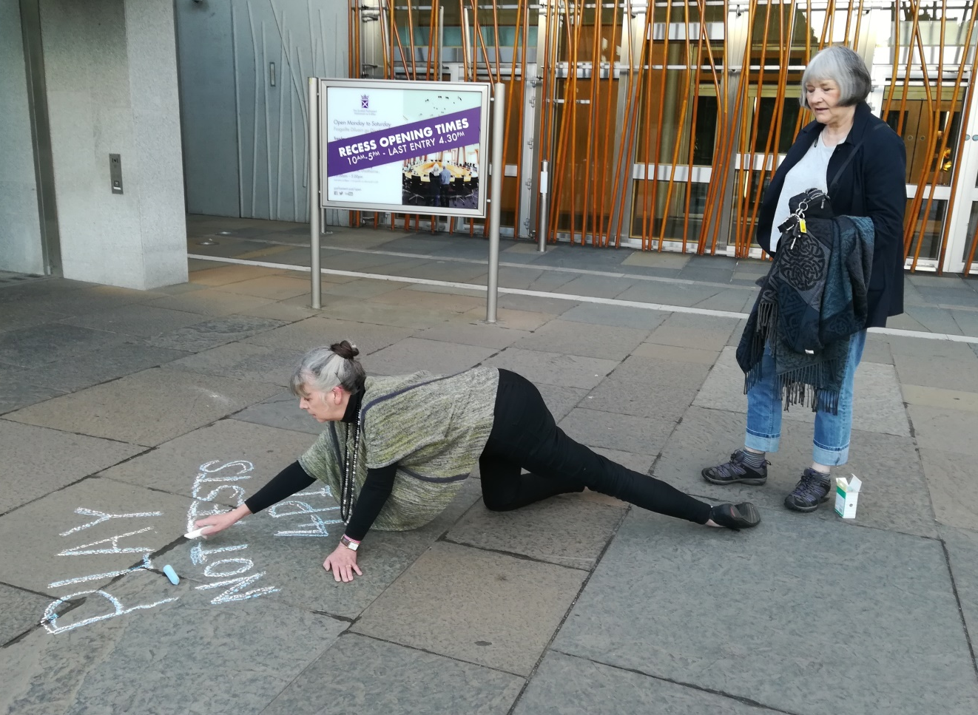
VOTES FOR WOMEN
PLAY NOT TESTS 4P1

Slide 5
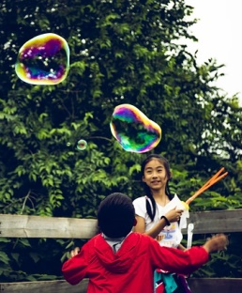

Slide 6
"An understanding of human biology tells us that young children need movement and free play to ensure the best developmental outcomes. Testing that focuses on literacy and numeracy skills puts adult attention in the wrong place. It generates data that distracts us, inevitably shaping what we adults think early years education should be about. The evidence tells us that what young children need is play, play and more play. Let's create an education system that gives them that. That's how we help Scotland to become best place in the world to grow up."

