Slide 1
NPF4 and Early Childhood

Slide 2
I’ll be 24 in 2045…

Slide 3
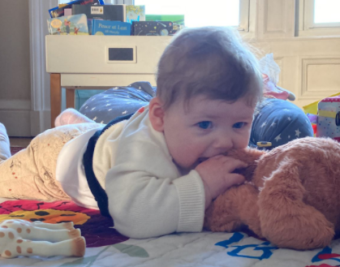
What’s your vision for Scotland over the next quarter century?
I want to PLAY!

Slide 4
Four criteria of NPF4:
Sustainable places
Liveable places
Productive places
Distinctive places

Slide 5
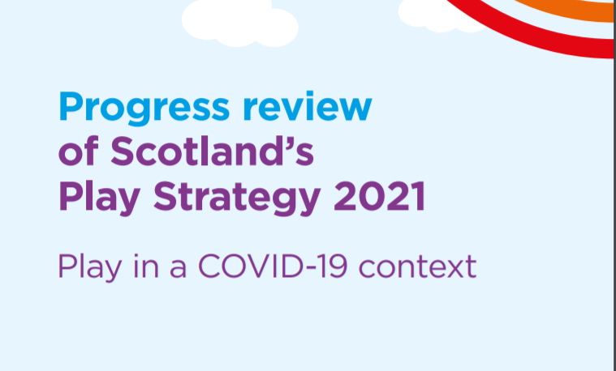
I want to PLAY!
Play as an intrinsic part of
human nature and experience
Play as a life-enhancing
daily experience

Slide 6
STATUTORY
Play as an intrinsic part of
human nature and experience
Play as a life-enhancing
daily experience

Slide 7
Scotland must make sufficient access to play a statutory requirement.

Slide 8
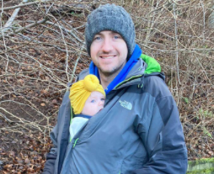
Scotland must make sufficient access to play a statutory requirement.
As often as possible outdoors!

Slide 9
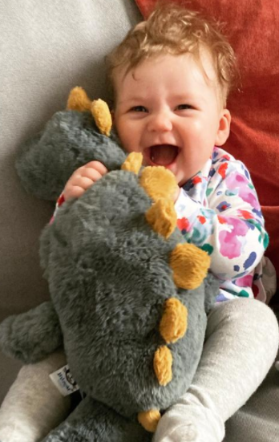
Every local authority (LA)
has its own
Local Development Plan (LDP)
…as part of which it has to do a PLAY SUFFICIENCY ASSESSMENT (PSA)!

Slide 10
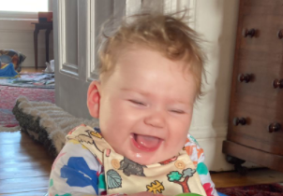
The PSA goes into an Evidence Report,
which goes into the LDP…
and there is a statutory duty on the LA to take full account of the Evidence Report!
BRILLIANT!!!!
PSA = Play Sufficiency Assessment
LDP = Local Development Plan
LA = Local Authority

Slide 11
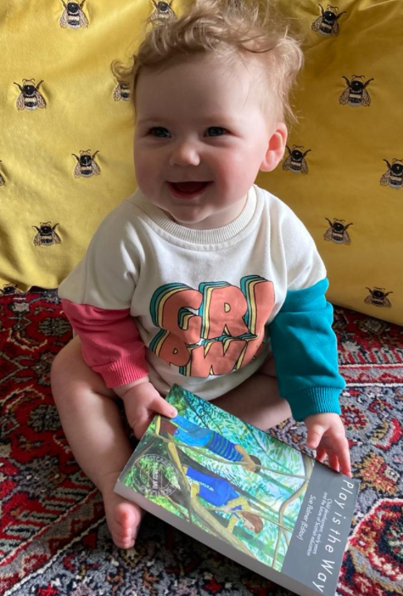
The PSA provides the evidence.
Why aren’t children in Scotland getting enough play?
And why isn’t the play good enough yet?

Slide 12
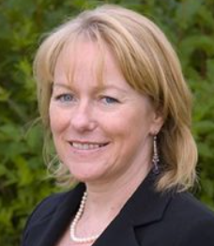
Relationships,
play and learning
in Scottish identity
Play is a very
misused adult
word
The myth of
early acceleration

Slide 13
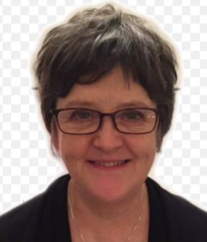
We need to make sure that the voices of children and young people are heard.
NPF4 and UNCRC
Children’s rights
and the move
towards a
kindergarten stage
Article
31

Slide 14
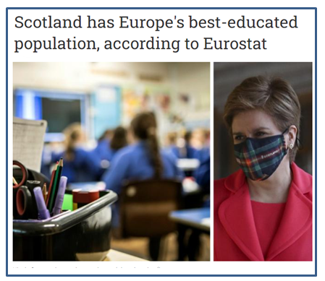
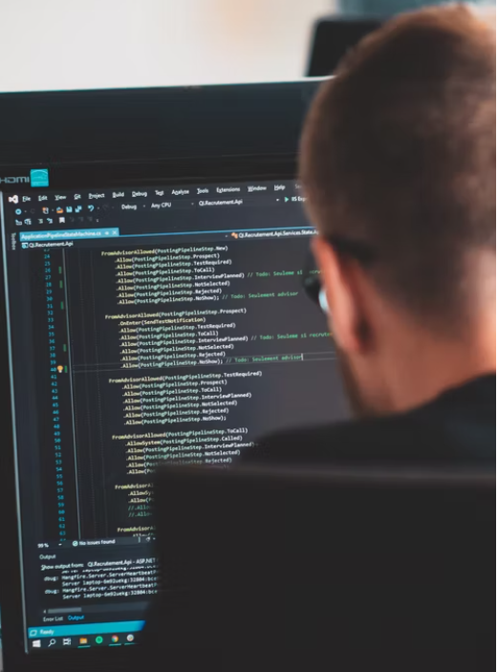
Our culture has never valued
play in the way it values
education.
The National, 15-2-22
Local authority policy-makers need
help to recognise that PLAY IS THE WAY for the under-sevens.
NPF4 gives us a vehicle to provide
that help.

Slide 15
Draw on the expertise
of the experts on play
Some great ideas on
this presentation by
Jenny Wood from APIC
(A Place In Childhood)

Slide 16
CALL TO ACTION!
LDPs and NPF4 need EVIDENCE of young children’s need
for play in their local area.
Your children can provide that evidence.
Is there sufficient access/provision for
active, social, outdoor play
- within the school grounds
- in their local neighbourhood?
How could the LA make it better?
Then please respond to two consultations.
Play Scotland has made it easy for you.
Contact them on info@playscotland.org

Slide 17
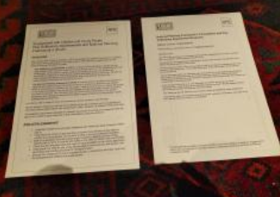
They’ll send you two presents
(I love presents!)
Info pack
Pro forma
Could you also send it
to your MSP?

Slide 18
Consultation on NPF4 closes on 31-3-22
Contact info@playscotland.org
for an information pack on how to do it.
PLEEEEEASE HELP!

Slide 19
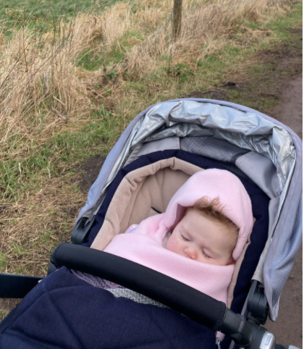
THANK YOU…
and good night…..

